Slide 1


Slide 2
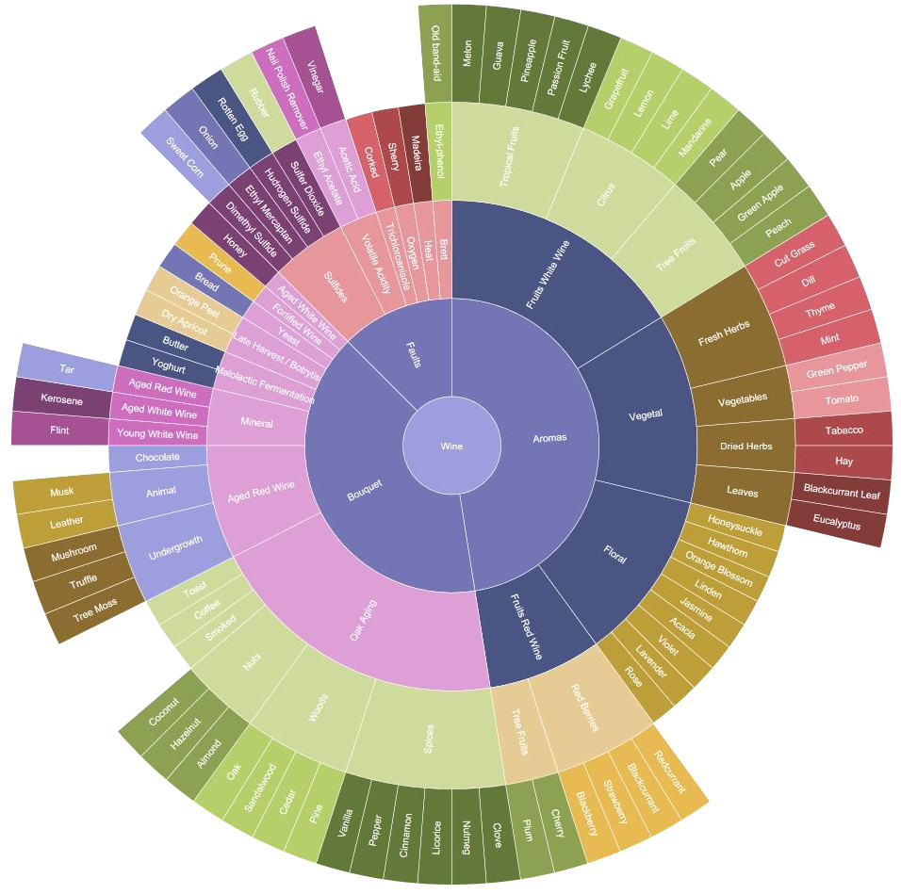
LEONARDO
Davide Carboni

Slide 3

1
INTRODUCTION
2
TECHNOLOGIES
3
PROJECT STRUCTURE
4
DATA DISPLAY
5
PROBLEMS
6
SELF LEARNING
7
CONCLUSION

Slide 4


START
DATA VISUALISATION
Notes:
Leonardo s’encadre dans le contexte de la visualisation des donnees

Slide 5
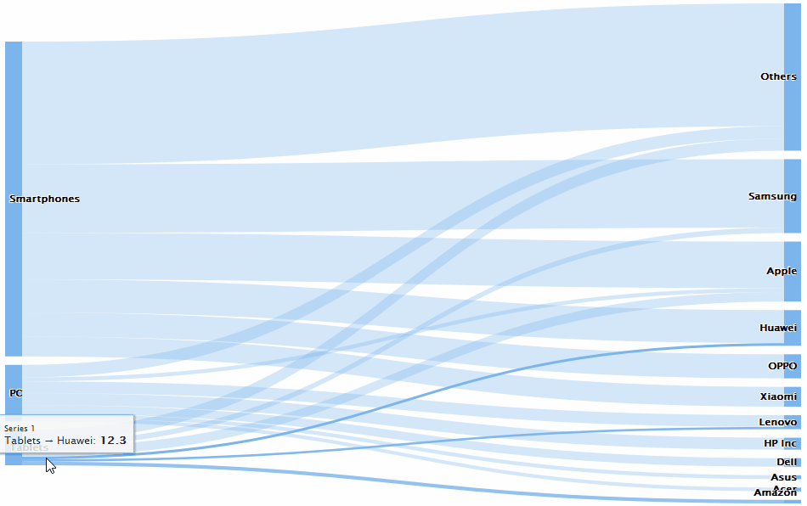

START
STRUCTURED DATA
Notes:
Le but donc

Slide 6



TECHNOLOGY
ANGULAR
HIGHCHARTS

Slide 7

TECHNOLOGY
ANGULAR
HIGHCHARTS
GOOGLE

Slide 8

TECHNOLOGY
ANGULAR
TYPESCRIPT
GOOGLE

Slide 9
TECHNOLOGY
ANGULAR
TYPESCRIPT
HIGHCHARTS

Slide 10

TECHNOLOGY
JAVASCRIPT
ANGULAR
HIGHCHARTS

Slide 11

TECHNOLOGY
JAVASCRIPT
HIGHCHARTS
CHARTS

Slide 12




MODULES
CONTROLLER
warns changes
updates
action
STRUCTURE
manipulates
connects
VIEW
reads
MODEL

Slide 13
HIGHCARTS-ANGULAR
MODULES
CONTROLLER
CONTROLLER
warns changes
warns changes
updates
reads
action
action
STRUCTURE
manipulates
manipulates
connects
reads
API / LOCAL
VIEW
MODEL
VIEW

Slide 14
HIGHCARTS-ANGULAR
API / LOCAL
reads
load
HIGHCARTS
CONTROLLER
CONTROLLER
warns changes
reads
warns changes
action
load
action
STRUCTURE
manipulates
manipulates
API / LOCAL
VIEW
VIEW

Slide 15
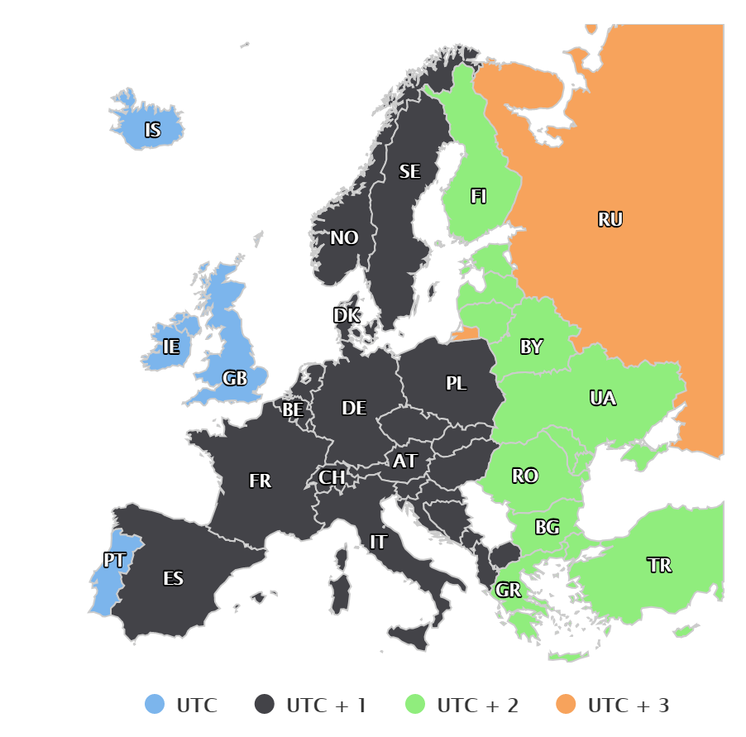
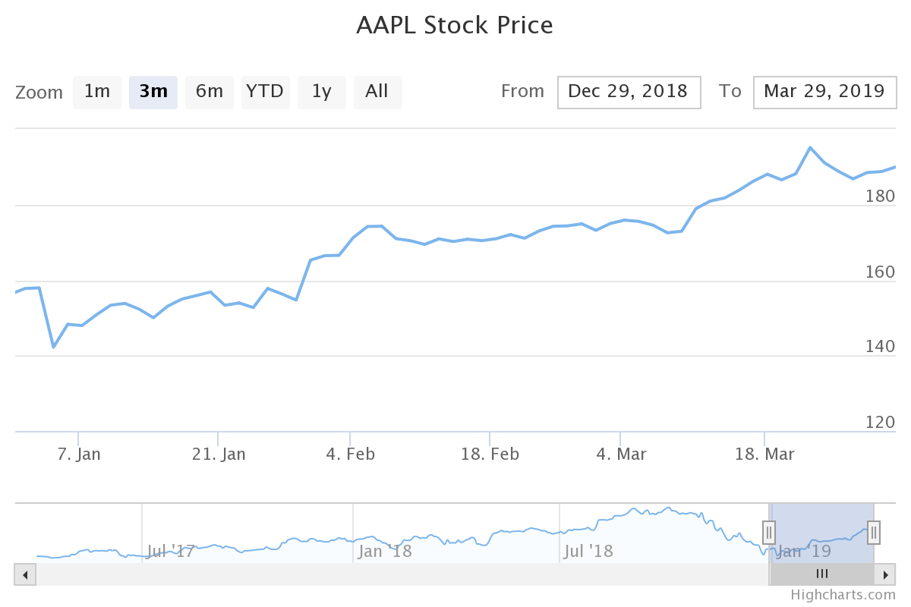
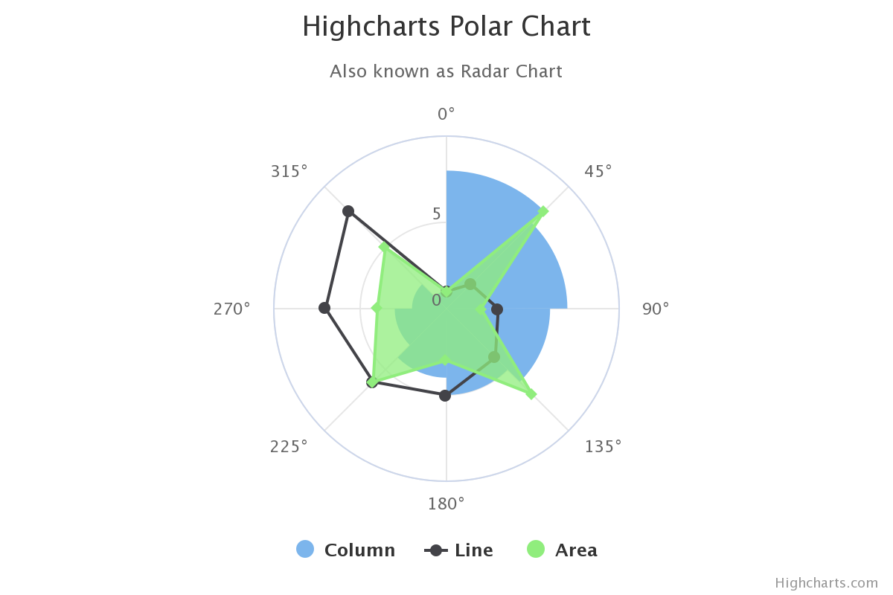

HIGHMAPS
HIGHSTOCK
HIGHCHARTS
VISUALISATION

Slide 16
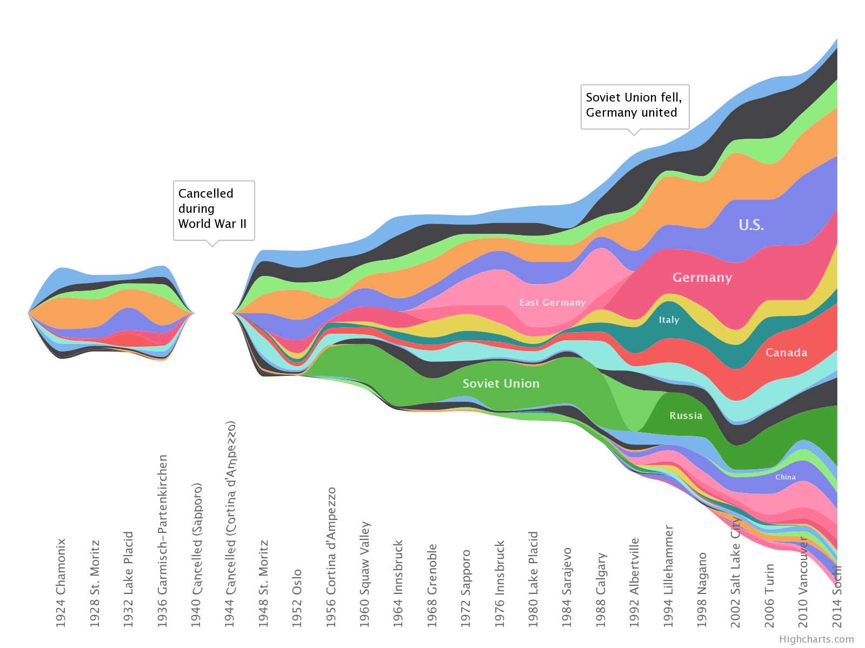
HIGHCHARTS
STREAM GRAPH
VISUALISATION
Notes:
Organigramme ou les donnée s

Slide 17
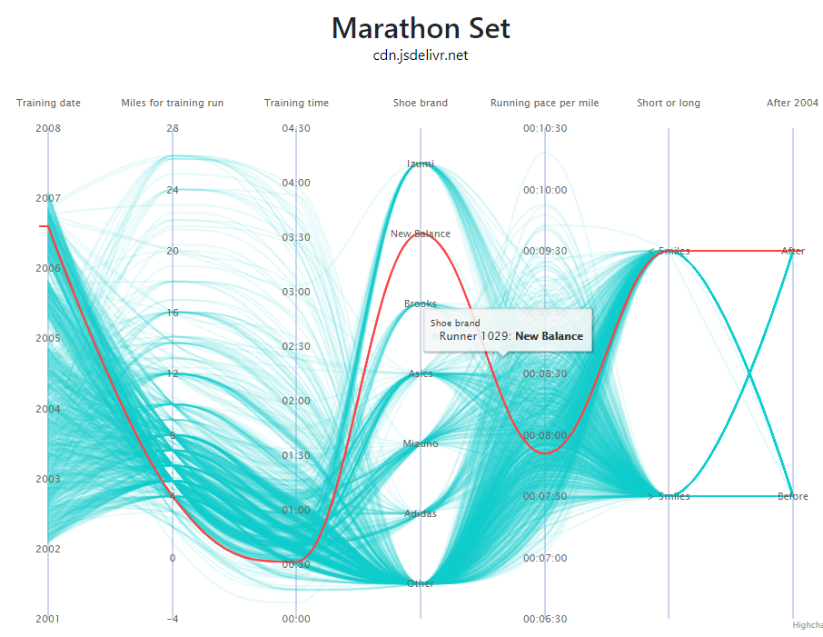
HIGHCHARTS
STREAM GRAPH
PARALLEL CORDINATES
VISUALISATION

Slide 18
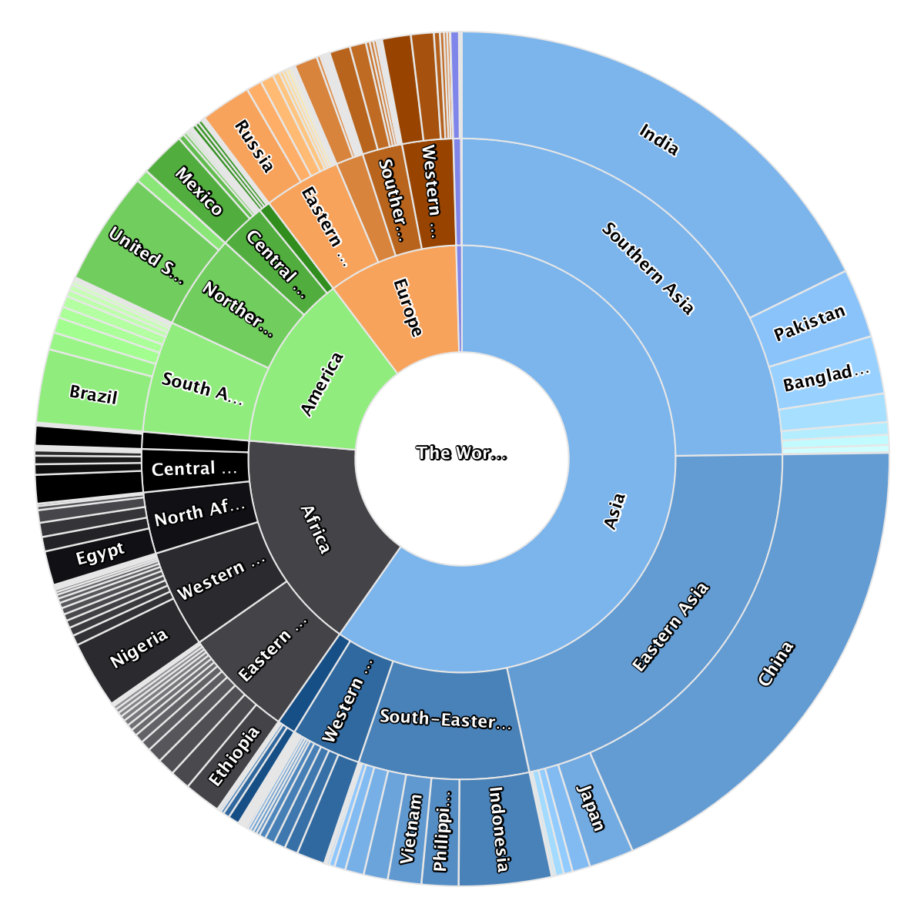
HIGHCHARTS
SUN BURST GRAPH
PARALLEL CORDINATES
VISUALISATION

Slide 19
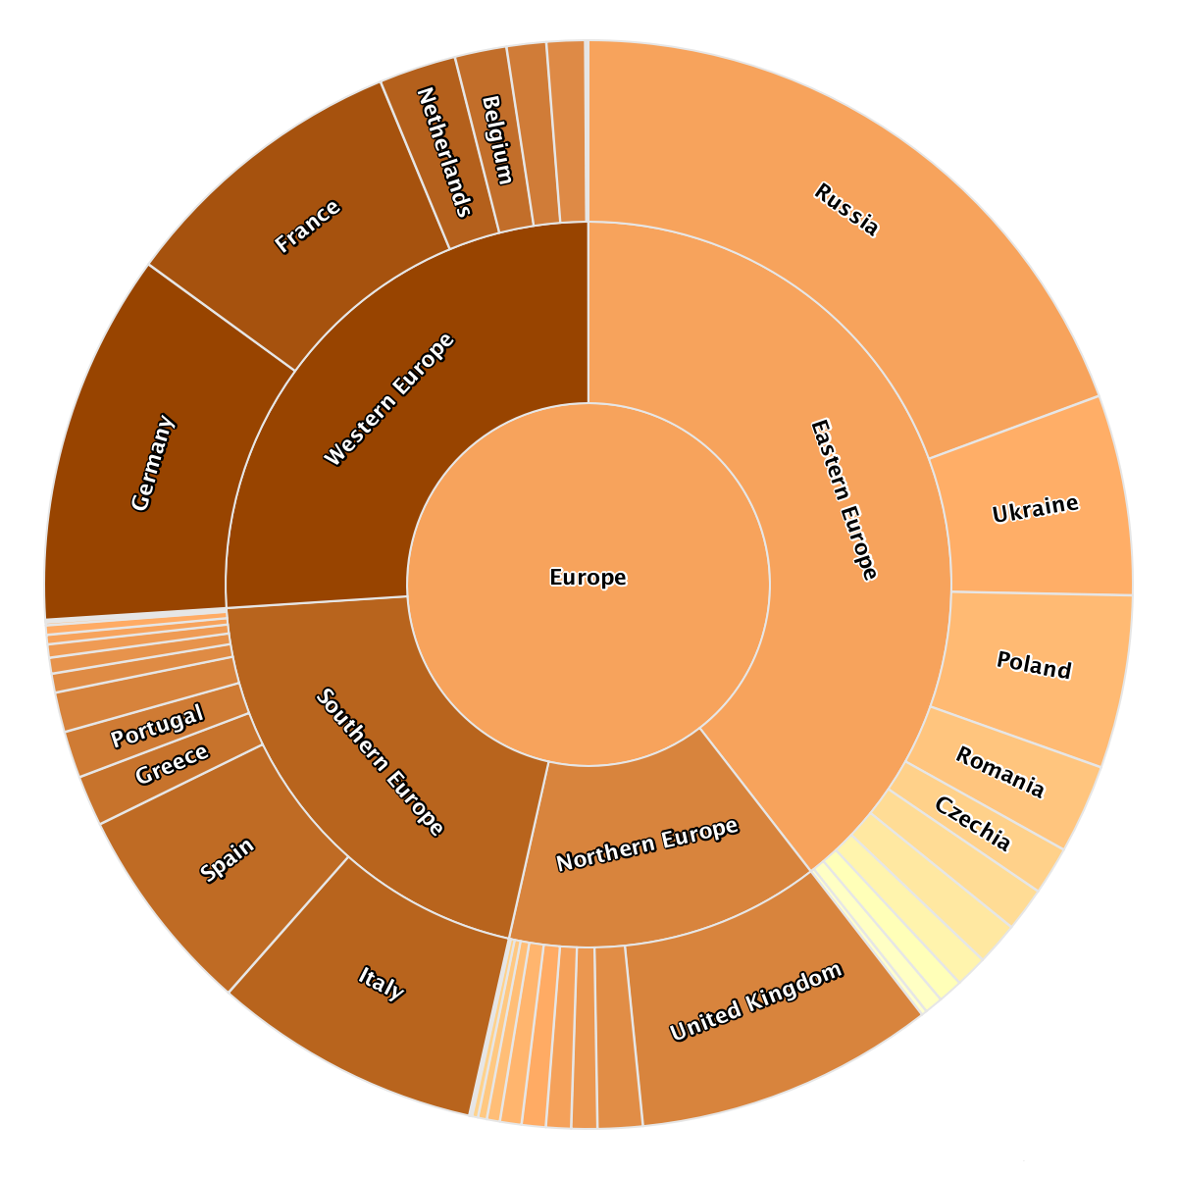
HIGHCHARTS
SUN BURST GRAPH
VISUALISATION

Slide 20
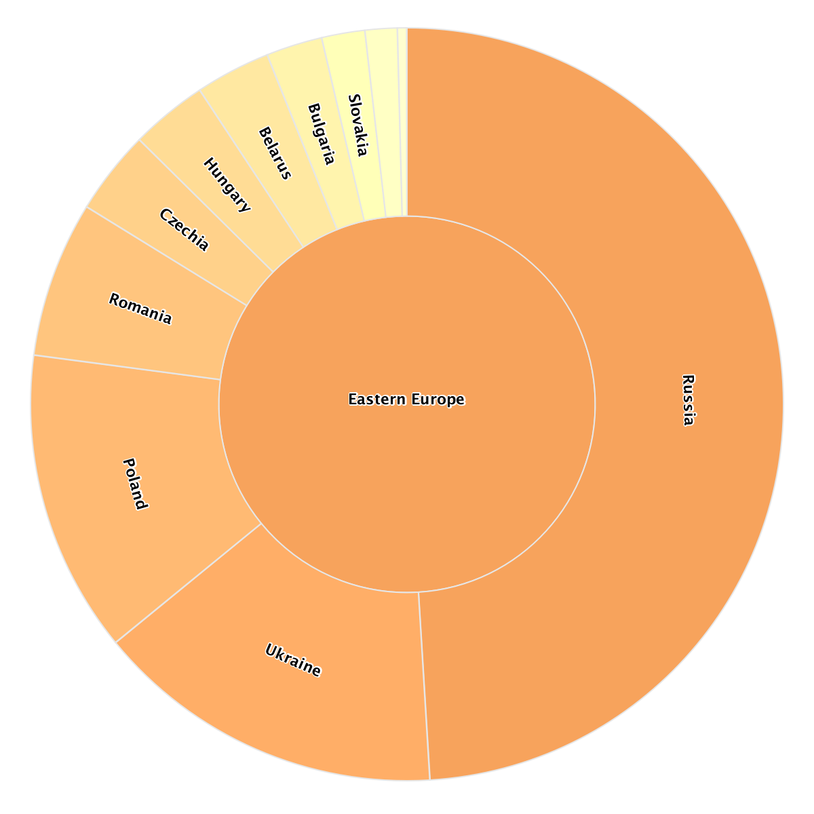
HIGHCHARTS
SUN BURST GRAPH
VISUALISATION

Slide 21
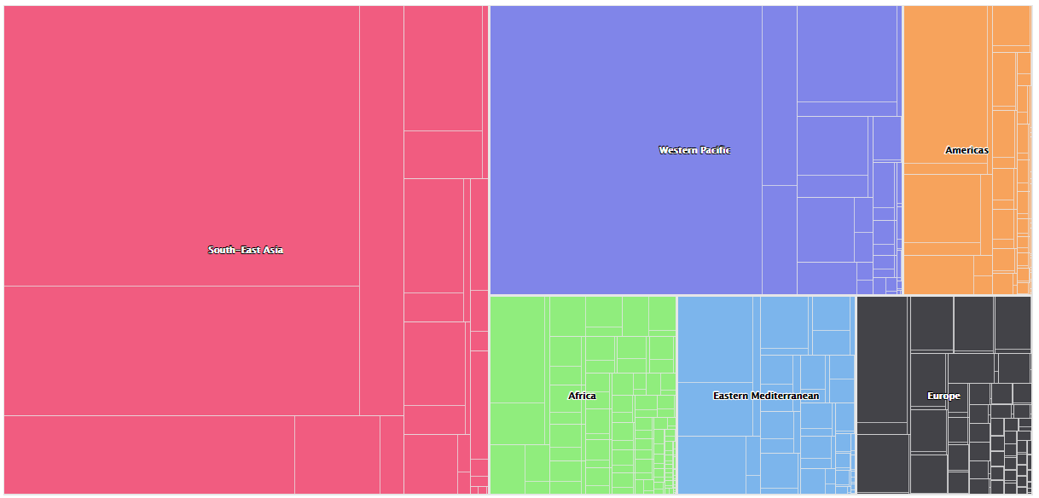
HIGHCHARTS
TREE MAP GRAPH
SUN BURST GRAPH
VISUALISATION

Slide 22
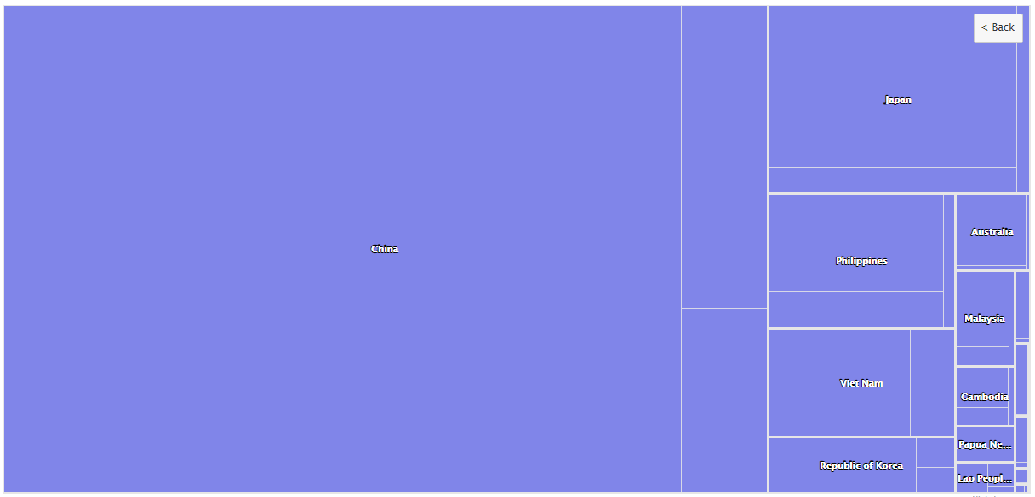
HIGHCHARTS
TREE MAP GRAPH
VISUALISATION

Slide 23
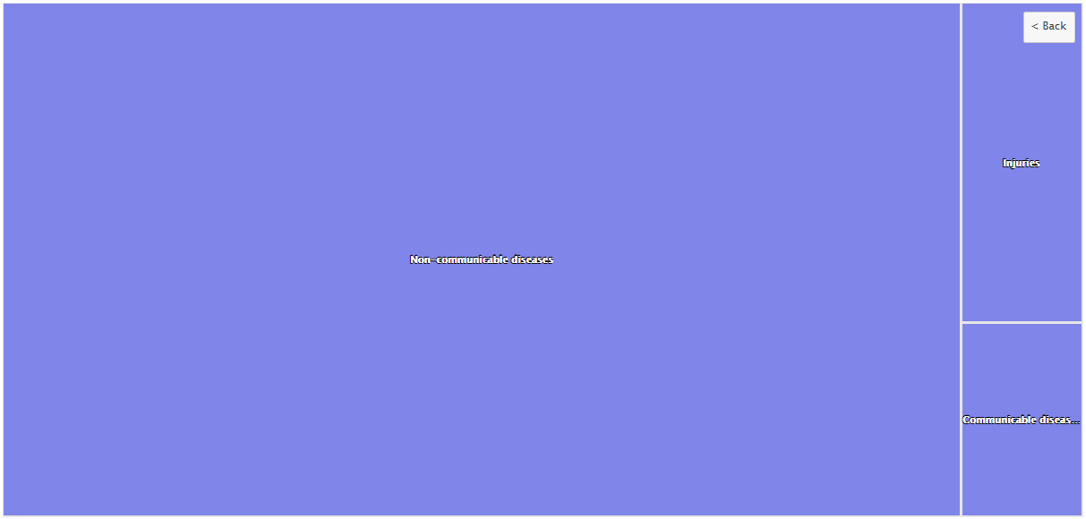
HIGHCHARTS
TREE MAP GRAPH
VISUALISATION

Slide 24

HIGHCARTS-ANGULAR
CONTROLLER
warns changes
reads
action
PROBLEMS
manipulates
API / LOCAL
VIEW

Slide 25
HIGHCARTS-ANGULAR
on load
CONTROLLER
STREAMGRAPH
SERIES-LABEL
warns changes
reads
action
SUNBURST
HEATMAP
PROBLEMS
manipulates
ANNOTATIONS
PARALLEL-CORDINATES
API / LOCAL
VIEW
TREEMAP
EXPORTING

Slide 26
HIGHCARTS-ANGULAR
on load
DYNAMIC-SCRIPT-LOADER
load only required
STREAMGRAPH
SERIES-LABEL
SERIES-LABEL
ANNOTATIONS
SUNBURST
HEATMAP
PROBLEMS
STREAMGRAPH
EXPORTING
PARALLEL-CORDINATES
ANNOTATIONS
TREEMAP
EXPORTING

Slide 27
API / LOCAL
DYNAMIC-SCRIPT-LOADER
load only required
reads
CONTROLLER
load
HIGHCARTS
load
warns changes
action
SERIES-LABEL
ANNOTATIONS
PROBLEMS
STREAMGRAPH
EXPORTING
manipulates
VIEW

Slide 28
DYNAMIC-SCRIPT-LOADER
API / LOCAL
load
use
reads
CONTROLLER
load
HIGHCARTS
load
warns changes
action
PROBLEMS
manipulates
VIEW

Slide 29




ANGULAR.IO
TUTORIALSPOINT.COM
HIGHCHARTS.COM
SCOTCH.IO
SELF LEARNING
STACKOVERFLOW.COM

Slide 30

SANDBOX
PAGES CREATE
ROUTES E CONTROLLERS
INSTALL / USE MODULES
SELF LEARNING
READ DATA FROM API
LEONARDO

Slide 31

1
2
3
FLEXIBLE
PRATICAL
INTEGRATED
CONCLUSION

Slide 32

QUESTIONS

